Slide 1
Problem Statement
As the deployment of 5G networks and the proliferation of edge computing continue to expand, there is a notable increase in the power consumption of networked devices. This surge not only elevates operational costs but also raises significant concerns about environmental sustainability. In response, governments worldwide are enforcing stringent regulations aimed at compelling enterprises to significantly reduce their power usage. These mandates are integral to broader global sustainability initiatives designed to lessen environmental impact and address the economic challenges posed by the increasing costs and volatility of energy resources. Such regulatory pressures necessitate innovative approaches to power management, pushing organizations to develop effective strategies to comply with new standards while maintaining technological advancement and operational efficiency.

Slide 2
Unique Idea Brief (Solution)
Advanced Monitoring: Implements a sophisticated system that continuously tracks power usage across CPUs, memory modules, NICs, and TDP to pinpoint inefficiencies.
Emissions Reduction: Aligns with zero-emission standards by providing detailed insights into power consumption patterns, aiding organizations in achieving significant energy reductions.
Operational Benefits:
Optimization: Proactively adjusts power settings to enhance system efficiency without compromising performance.
Compliance: Helps meet stringent environmental regulations, reducing operational risks and contributing to sustainability goals.
Strategic Impact:
Cost Efficiency: Lowers energy expenses by optimizing power use.
Corporate Responsibility: Supports corporate initiatives for environmental sustainability and responsible energy use.

Slide 3
Features Offered
Real-Time Monitoring: Enables continuous surveillance of energy usage across essential system components such as CPUs, memory, NICs, and TDP, allowing for immediate detection and response to inefficiencies.
Predictive Analytics: Leverages historical power data to predict future consumption patterns and identify potential inefficiencies, enabling preemptive action to optimize energy usage and prevent wastage.
Automated Control Systems: Integrates intelligent automation to dynamically adjust power settings and system operations based on real-time data, enhancing overall energy efficiency without manual intervention.
Scalability: Ensures the solution can be effectively deployed across various hardware and software environments, from small setups to extensive enterprise systems, facilitating easy expansion as organizational needs grow.
Customizable Dashboards: Provides tailored user interfaces that display critical telemetry data and analytics in an accessible format, helping stakeholders make informed decisions about energy management and operational adjustments.

Slide 4
Process flow
Data Collection:
Utilizing Automated Tools and Sensors: Our system employs a range of automated tools and sensors to gather detailed telemetry data from various critical components including CPUs, memory modules, NICs, and TDP.
Comprehensive Coverage and Accuracy: Ensures all relevant data points are captured accurately to provide a holistic view of the system’s power usage.
Data Analysis:
Applying Sophisticated Algorithms: Advanced algorithms analyze the collected telemetry data to assess power consumption patterns and operational efficiency.
Identifying Areas for Improvement: Pinpoints inefficiencies and potential areas where power usage can be optimized.

Slide 5
Process flow
Actionable Insights:
Synthesizing Analyzed Data: The system processes and synthesizes the analyzed data into clear, actionable insights.
Enabling Targeted Interventions: Provides recommendations for targeted interventions that can lead to significant power savings and efficiency improvements.

Slide 6
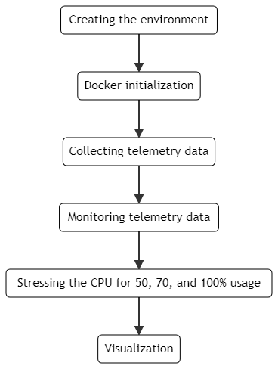
Architecture Diagram

Slide 7
Technologies used
Programming Tools: The system is developed using Python and C, which are chosen for their robust capabilities in data manipulation, performance efficiency, and wide support for analytical libraries.
Operating Platforms: It runs on a Linux-based environment, utilizing the strengths of open-source for better customization, security, and stability.
Containerization and Orchestration: Kubernetes is used for managing containerized applications, with Docker ensuring that each component is isolated, replicable, and scalable, making deployment flexible and reliable.

Slide 8
Technologies used
Libraries Used:
Key Libraries/Tools Used:
1. dmidecode:
- Purpose: To fetch detailed hardware information such as Thermal Design Power (TDP).
2. ifstat:
- Purpose: To monitor network interface statistics.
3. free:
- Purpose: To display system memory usage.

Slide 9
Technologies used
Libraries Used:
4. top:
- Purpose: To display real-time CPU usage.
5. docker:
- Purpose: To manage containers, used here for running stress tests and cAdvisor.
6. bc:
- Purpose: For performing arithmetic operations, calculating CPU workers for stress tests.

Slide 10
Team members and contribution:

Slide 11
Conclusion
In conclusion, the Power Manager Telemetry project addresses the critical challenge of increasing power consumption in the era of 5G and edge computing by providing a sophisticated system for real-time monitoring and optimization of power usage across essential system components. By leveraging advanced telemetry and predictive analytics, our solution offers detailed insights into power consumption patterns, enabling organizations to make informed decisions and proactive adjustments. This not only helps in achieving significant energy savings and operational efficiency but also ensures compliance with stringent environmental regulations aimed at reducing emissions and promoting sustainability. The project's scalable architecture allows for flexible implementation across diverse hardware environments, making it a viable solution for both small-scale setups and extensive enterprise systems. As we move forward, the potential for future enhancements, such as integrating machine learning models for even more precise predictions and expanding the system's capabilities, holds promise for further advancing the efficiency and sustainability of power management practices.

